Slide 1



Synopsis Presentation on
Guided By: Presented By:
Prof. Shahida Khan Kratika Jain (0827IT221079)
Pratham Bothra (0827IT221112)
Saloni Jain (0827IT221128)
Urvashi Yadav (0827IT221147)
CHECKIT
Click. Check. Done.

Slide 2
Contents
Introduction
1.1 Overview
1.2 Purpose
Literature Review
Problem Statement
Proposed Solution
Objectives
Theoretical Analysis
6.1 Block Diagram
6.2 Hardware Requirements
6.3 Software Requirements
Applications
REFERENCES

Slide 3
1. Introduction
1.1 Overview
CheckIT is a web-based ERP platform developed to modernize and automate academic management, particularly attendance and communication. It integrates Google Forms and Sheets, enabling a streamlined and accessible interface for students, faculty, and administrators.
1.2 Purpose
Automate student attendance tracking
Enhance academic communication
Provide centralized access to notes and timetables
Issue real-time alerts and reminders
Encourage efficient academic management

Slide 4
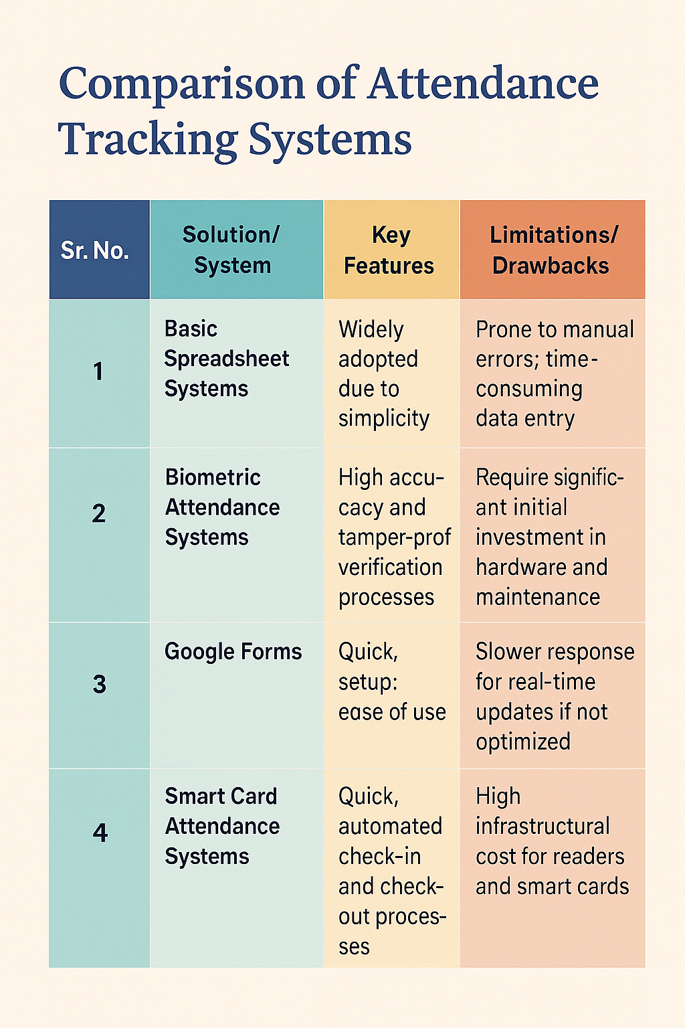
2. Literature Review

Slide 5
3. Problem Statement
No centralized platform for notes, reminders or timetable.
Lack of real-time alerts for students and faculty.
Students cannot easily manage tasks or receive updates promptly.
Data inconsistency due to scattered tools.
Manual attendance systems are outdated, inefficient and error prone.

Slide 6
4. Proposed Solution
Digital Attendance: Students mark attendance via Google Forms, reducing manual errors and saving time.
Real-Time Data Management: Attendance data is synced instantly with Google Sheets and stored securely in MySQL.
Smart Notifications: Sends alerts to students for low attendance and reminds faculty about upcoming lectures.
Role-Based Access: Admin, faculty, and students each have personalized access to relevant features.
Academic Resource Sharing: Faculty can upload notes and class timetables for easy student access.
Task & Reminder Module: Users can create to-do lists and receive reminders to stay organized.

Slide 7
5. Objectives
Dynamic Class Selection Faculty chooses a class from a dropdown menu, triggering the system to load the corresponding student roster in real time.
Real-Time Attendance Marking Once students are loaded, faculty can directly mark attendance (e.g., via checkboxes or toggles) on the same interface, eliminating the need for separate forms.
Automated Data Storage The attendance data is automatically recorded into subject-specific sheets or sections, which simplifies subsequent analysis and record-keeping.
Academic Data Integration The system features additional modules, such as a class timetable and an academic calendar with holidays, providing a holistic academic management environment.
Role-Based Access Control Faculty have full editing rights to update records, while students have a view-only version of the compiled attendance for transparency.

Slide 8
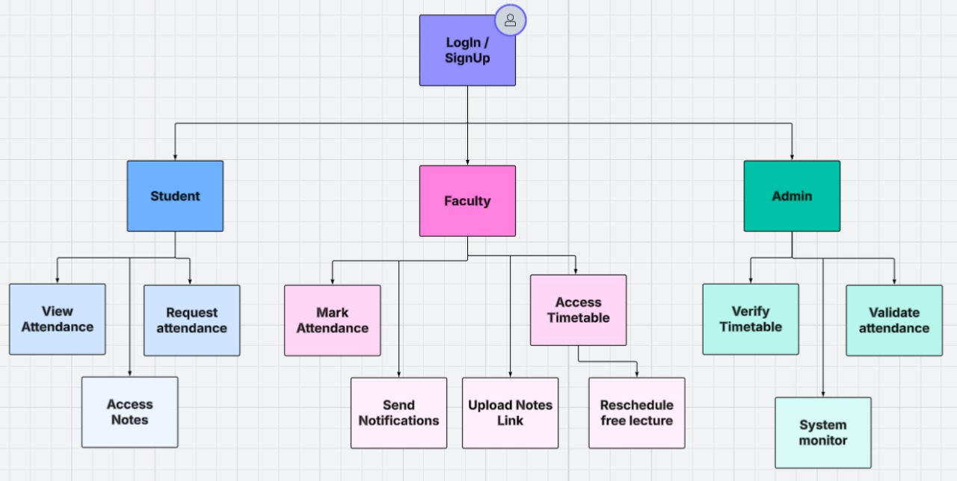
6. Theoretical Analysis
Fig.1. Flow Diagram

Slide 9


6.2 Hardware Requirements
CPU: Multi-core processor
6.3 Software Requirement
Frontend - HTML5, CSS3, JavaScript, ReactJS, Tailwind.
RAM: Minimum of 8GB, but for large user bases, 16GB or more.
SSD storage for faster read/write speeds, around 250GB or more depending on content volume.
High-speed internet connectivity to ensure fast response times and reliable service.
Backend – Node.js, Apache
APIs for synchronization with Google Sheets.

Slide 10
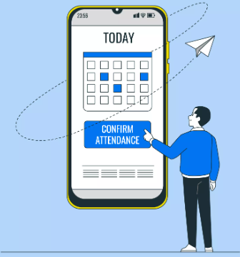
7. Applications
Scalability for Institutions: Adaptable to various sizes of academic institutions, allowing for easy upgrades and integration with other administrative systems.
Analytical Reporting: The centralized system can easily generate attendance reports and analytics, supporting performance evaluations and institutional decision-making.
Error Reduction and Efficiency: The dynamic student roster integration minimizes manual data entry errors and streamlines the overall process, saving administrative time.
Real-Time Attendance Recording: Faculty can quickly load a class’s student roster and mark attendance directly, ensuring immediate data capture and eliminating delays.

Slide 11

GitHub Link
https://github.com/Saloni-Jain25/checkit

Slide 12

REFERENCES
Sonawane, R. K., & Singh, A. T. (2023). Importance and Impact of Attendance Management System: A Literature Review. International Journal of Advanced Research in Science, Communication and Technology, 3(5), 328.
Ali, N. S., Alhilali, A. H., Rjeib, H. D., Alsharqi, H., & Al-Sadawi, B. (2022). Automated Attendance Management Systems: Systematic Literature Review. International Journal of Technology Enhanced Learning, 14(1), 37–65.
Soundarya, S., Ashwini, P., Rucha, W., Gaurav, K., & Patil, M. S. A Review Paper on Attendance Management System Using Face Recognition. International Journal of Computer Research Trends.

Slide 13

Thank You
Any Queries ?

